Slide 1
Gitlab
October 2017

Slide 2
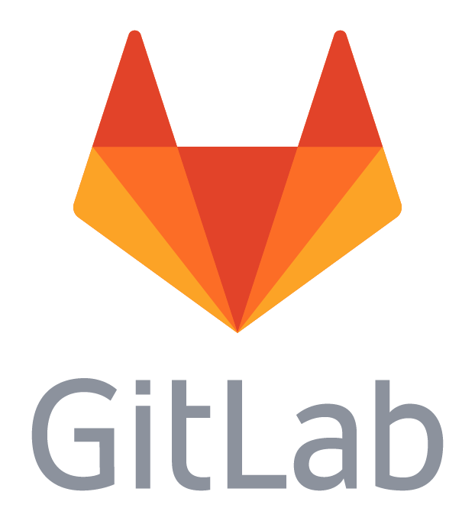
gitlab
Overview
Code collaboration platform that enables developers to create, review, and deploy code bases
Written in Ruby
An open source project (Community Edition)
Launched in 2014 and is operated from San Francisco, California.

Slide 3

gitlab
Features
GitLab is a framework that manages Git repositories and allows to deploy repositories easily.
Choosing a Git repository management system has become important in recent times. Individuals and teams are looking for easy to use, cheap, and open source repository management systems. And GitLab is one of the best Git repository management systems available . It is open-source, has web-based Git repository management, wiki and issue tracking system. It is a great tool that allows centralized management of Git repositories. It has a user friendly web interface and the possibility of managing permissions. This article provides a complete overview of the product, comparison with similar products and problems associated with it.
GIT REPOSITORY MANAGEMENT

Slide 4
gitlab
Features
Project webhooks allow you to trigger a URL if for example new code is pushed or a new issue is created. You can configure webhooks to listen for specific events like pushes, issues or merge requests. GitLab will send a POST request with data to the webhook URL.
Webhooks can be used to update an external issue tracker, trigger CI jobs, update a backup mirror, or even deploy to your production server.
WEB
HOOKS

Slide 5
gitlab
Features
GitLab integrates with LDAP to support user authentication. This integration works with most LDAP-compliant directory servers, including Microsoft Active Directory, Apple Open Directory, Open LDAP, and 389 Server. GitLab EE includes enhanced integration, including group membership syncing.
LDAP
GROUP SYNC

Slide 6
gitlab
Features
A separate system for documentation called Wiki, is built right into each GitLab project. It is enabled by default on all new projects and you can find it under Wiki in your project.
Wikis are very convenient if you don't want to keep your documentation in your repository, but you do want to keep it in the same project where your code resides.
You can create Wiki pages in the web interface or locally using Git since every Wiki is a separate Git repository.
WIKIS

Slide 7
gitlab
Features
Repository Mirroring is a way to mirror repositories from external sources. It can be used to mirror all branches, tags, and commits that you have in your repository.
Your mirror at GitLab will be updated automatically. You can also manually trigger an update at most once every 5 minutes.
Repository mirroring is very useful when, for some reason, you must use a project from another source.
There are two kinds of repository mirroring features supported by GitLab: push and pull. The push method mirrors the repository in GitLab to another location, whereas the pull method mirrors an external repository in one in GitLab.
REPOSITORY
MIRRORING

Slide 8

gitlab
Features
Git natively supports hooks that are executed on different actions.
Normally, Git hooks are placed in the repository or project's hooks directory. GitLab creates a symlink from each project's hooks directory to the gitlab-shell hooks directory for ease of maintenance between gitlab-shell upgrades. As such, custom hooks are implemented a little differently. Behavior is exactly the same once the hook is created, though.
Note: Custom Git hooks must be configured on the filesystem of the GitLab server. Only GitLab server administrators will be able to complete these tasks.
GIT
HOOKS

Slide 9
gitlab
Features
Track issues and communicate progress without switching between products.
It’s more than a visual representation. It’s your issues, your labels, and all the metadata that comes with them. And you still have all of the same sorting and filtering tools that you use across GitLab.
Flexible setup
ISSUE MANAGEMENT

Slide 10
gitlab
Features
A small amount of code, usually selected for the purpose of showing other developers how to do something specific or reproduce a problem.
Snippets in GitLab can be either private, internal, or public. You can set it with the visability field in the snippet.
CODE SNIPPETS

Slide 11
gitlab
Features
Sometimes it's easier to make quick changes directly from the GitLab interface than to clone the project and use the Git command line tool. In this feature highlight we look at how you can create a new file, directory, branch or tag from the file browser. All of these actions are available from a single dropdown menu.
FILE BROWSER

Slide 12
gitlab
Features
View a list of the latest commits, merges, comments, and team members on your project.
ACTIVITY STREAM

Slide 13
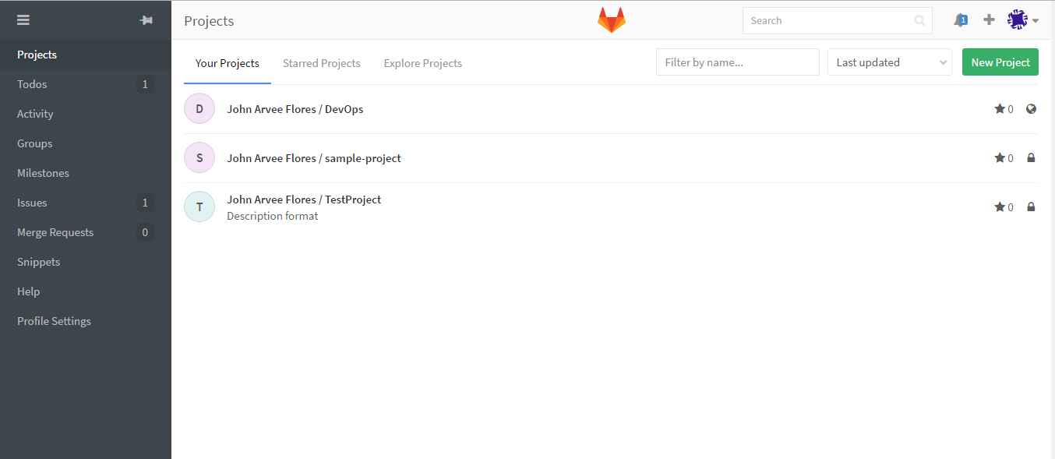
gitlab
Project Dashboard

Slide 14
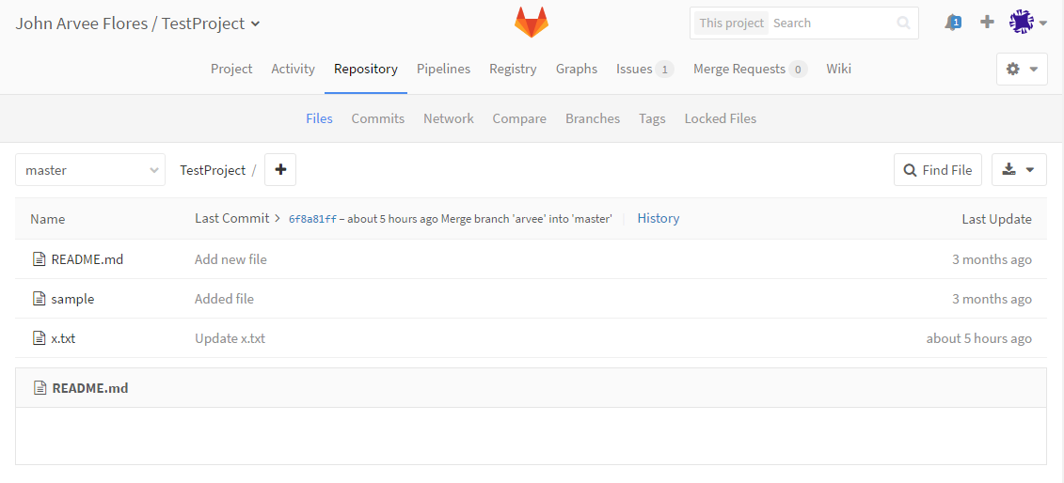
gitlab
Repository Files

Slide 15
gitlab
References
https://www.upwork.com/hiring/development/gitlab-vs-github-how-are-they-different/
https://about.gitlab.com/
https://about.gitlab.com/features/#stq=activity+stream&stp=1
https://about.gitlab.com/features/

